Slide 1
Internet of Things
IO 4041
Transport Layer

Slide 2
Transport Layer
Transport protocols reside on top of IP
Applications do not use IP directly,
  but use the transport protocols to communicate with each other.
In IP protocol stack, most widely used transport protocols
  User Datagram Protocol (UDP), and
  Transport Control Protocol (TCP).

Slide 3


















Transport services and protocols
application
transport
network
data link
physical
provide logical communication between app processes running on different hosts
transport protocols run in end systems
  send side: breaks app messages into segments, passes to network layer
  rcv side: reassembles segments into messages, passes to app layer
more than one transport protocol available to apps
  Internet: TCP and UDP
logical end-end transport
application
transport
network
data link
physical
3-<number>
Notes:
By Logical communication, we mean that from an application’s perspective, it is as if the hosts running the processes were directly connected; in reality, the hosts may be on opposite sides of the planet, connected via numerous routers and a wide range of link types.
Segments: done by (possibly) breaking the application messages into smaller chunks and adding a transport-layer header to each chunk to create the transport-layer segment.

Slide 4
Transport Layer
UDP is a best-effort delivery service, which does not add much on top of IP, whereas
TCP is a reliable byte stream that adds a connection abstraction on top of the connectionless IP.
Although there have been several other transport protocols defined,
  such as SCTP [229] and DCCP [152],
  they have as yet to be adopted by the mainstream.
Notes:
DCCP: Datagram Congestion Control Protocol
SCTP: Stream Control Transmission Protocol

Slide 5
Transport Layer
Usually, basic unit of transportation is called a Packet
data from higher layers are transported in these packets
In UDP, the basic unit of transportation is called a user datagram (or UDP segment)
In TCP, basic unit of transportation is called a segment (TCP segment)

Slide 6
UDP: User Datagram Protocol [RFC 768]
Best effort delivery service:
As the underlying IP network does its best to deliver the datagram,
  but does not guarantee delivery of the datagrams at the destination [may loss]
  Does not guarantee that the datagrams are delivered in the same order as they were sent [can be delivered out of order]

Slide 7
UDP: User Datagram Protocol [RFC 768]
Connectionless
no handshaking between UDP sender, receiver
each UDP segment handled independently of others
Uses
streaming multimedia apps (loss tolerant, rate sensitive): real time audio/video
DNS look ups
reliable transfer over UDP
add reliability at application layer
application-specific error recovery!

Slide 8
In the context of smart object networks,
UDP [due to its simplicity and lightweight nature]
  is an exciting choice for quick transportation of sensor data

Slide 9
UDP: segment header
length, in bytes of UDP segment, including header
32 bits
source port #
dest port #
length
checksum
why is there a UDP?
no connection establishment (which can add delay)
simple: no connection state at sender, receiver
small header size
no congestion control: UDP can blast away as fast as desired
application
data
(payload)
UDP segment format
Notes:
UDP header is 8 bytes.

Slide 10
UDP checksum
Goal: detect “errors” (e.g., flipped bits) in transmitted segment
sender:
treat segment contents, including header fields, as sequence of 16-bit integers
checksum: addition (one’s complement sum) of segment contents
sender puts checksum value into UDP checksum field
receiver:
compute checksum of received segment
check if computed checksum equals checksum field value:
  NO - error detected
  YES - no error detected. But maybe errors nonetheless? More later ….

Slide 11
Internet checksum: example
example: add two 16-bit integers
1 1 1 1 0 0 1 1 0 0 1 1 0 0 1 1 0
1 1 1 0 1 0 1 0 1 0 1 0 1 0 1 0 1
1 1 0 1 1 1 0 1 1 1 0 1 1 1 0 1 1
1 1 0 1 1 1 0 1 1 1 0 1 1 1 1 0 0
1 0 1 0 0 0 1 0 0 0 1 0 0 0 0 1 1
wraparound
sum
checksum
Note: when adding numbers, a carryout from the most significant bit needs to be added to the result

Slide 12
TCP: Overview RFCs: 793,1122,1323, 2018, 2581
point-to-point:
  one sender, one receiver
reliable, in-order byte stream:
  no “message boundaries”
pipelined:
  TCP congestion and flow control set window size
full duplex data:
  bi-directional data flow in same connection
  MSS: maximum segment size
connection-oriented:
  handshaking (exchange of control msgs) inits sender, receiver state before data exchange
flow controlled:
  sender will not overwhelm receiver
Notes:
Similarities with GBN: cumulative ack, one timer for multiple packets,
Similarities with Selective repeat: Maintains a buffer at receiver and keeps out-of-order newly arrived packets.

Slide 13
Transmission Control Protocol (TCP)
A standard that defines how to establish and maintain a conversation so that application layer protocols can share/exchange data
provides a reliable byte stream on top of the best-effort packet service provided by the IP layer
It is based on client-server model
  Client gets a service from a server, i.e., a web page
Since IoT devices offer a varying traffic pattern
  So TCP is not suitable for IoT applications
uIP, an implementation of TCP for memory-constrained smart objects.

Slide 14
Transmission Control Protocol (TCP)
Reliability is achieved by buffering data combined with positive ACKs and retransmissions
Before any data are transported, the two connection end points must explicitly set up a connection.
A connection is identified by the IP addresses and TCP port numbers of the end points
Many application layer protocols are defined over TCP,
  such as HTTP (Web), SMTP (e-mail), and XMPP (instant messaging).

Slide 15
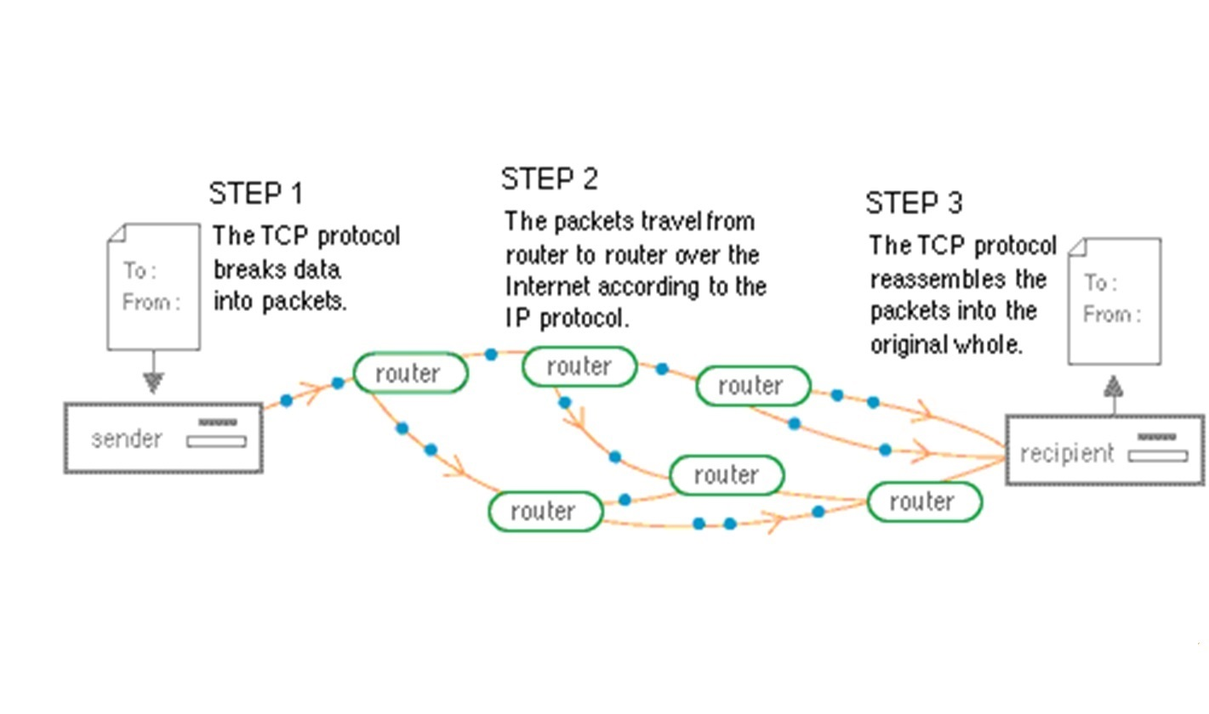
Transmission Control Protocol (TCP)

Slide 16
TCP segment structure
32 bits
URG: urgent data
(generally not used)
counting
by bytes
of data
(not segments!)
source port #
dest port #
sequence number
ACK: ACK #
valid
acknowledgement number
head
len
not
used
U
receive window
A
PSH: push data now
(generally not used)
P
R
S
F
# bytes
rcvr willing
to accept
(Flow Control)
checksum
Urg data pointer
RST, SYN, FIN:
connection estab
(setup, teardown
commands)
options (variable length)
application
data
(variable length)
Internet
checksum
(as in UDP)
Notes:
Head len: These bits represent the size of the header in 32 bit words. TCP minimum header size is 20 bytes so the value of head len is 5 usually. Max header size: 60 bytes, allowing 40 bytes of options.
PSH: indicates that receiver should pass data to upper layer (receiving application) immediately.
URG: indicates that there is data in this segment marked as urgent by sender side application layer.
RST ( R) SYN (S) and FIN (F): used to connection set up and teardown
Others: ECN: explicit congestion notification, CWR: congestion window reduced.
Question: how much can the application data size be in a packet?
Ans: Depends on the link layer protocol, medium. MTU basically.! Or path MTU in IPv6 for that matter. MSS is agreed upon at the start of the connection between two end systems.

Slide 17
TCP seq. numbers, ACKs
outgoing segment from sender
sequence numbers:
  byte stream “number” of the first byte in segment’s data
acknowledgements:
  seq # of next byte expected from other side
  cumulative ACK
Q: how receiver handles out-of-order segments
  A: TCP spec doesn’t say, - up to implementor
source port #
dest port #
sequence number
acknowledgement number
rwnd
checksum
urg pointer
window size
N
  sender sequence number space
sent
ACKed
sent, not-yet ACKed
(“in-flight”)
usable
but not
yet sent
not
usable
incoming segment to sender
source port #
dest port #
sequence number
acknowledgement number
A
rwnd
checksum
urg pointer
Notes:
Sequence numbers are over the stream of transmitted bytes (not over the series of transmitted segments).
Host A has a data stream consisting of a file 5000000 bytes. MSS is 1000 bytes so 500 MSS will be there. 1st has sequence # as 0, 2nd as 1000 and so on.
TCP acknowledges bytes upto 1st missing byte in the stream, thus it provides cumulative acknowledgement)

Slide 18
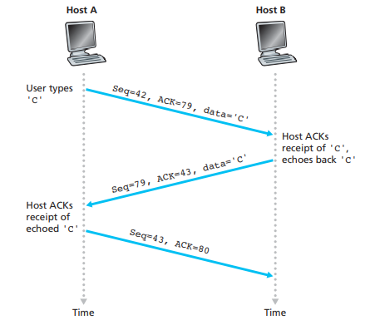
A simple Telnet Application over TCP

Slide 19
TCP round trip time, timeout
Q: how to set TCP timeout value?
longer than RTT
  but RTT varies
too short: premature timeout, unnecessary retransmissions
too long: slow reaction to segment loss
Q: how to estimate RTT?
SampleRTT: measured time from segment transmission until ACK receipt
  ignore retransmissions
SampleRTT will vary, want estimated RTT “smoother”
  average several recent measurements, not just current SampleRTT
Notes:
Length of TCP timeout? Larger than connection RTT time

Slide 20
TCP reliable data transfer
TCP creates rdt service on top of IP’s unreliable service
  pipelined segments
  cumulative acks
  single retransmission timer
retransmissions triggered by:
  timeout events
  duplicate acks
let’s initially consider simplified TCP sender:
  ignore duplicate acks
  ignore flow control, congestion control
Notes:
Original TCP: uses cumulative ACK from go back N and a single timer but retransmits only the oldest packet if time is out.
Similarities with GBN: cumulative ack, one timer for multiple packets,
Similarities with Selective repeat: Maintains a buffer at receiver and keeps out-of-order newly arrived packets.

Slide 21
TCP sender events:
data rcvd from app:
create segment with seq #
seq # is byte-stream number of first data byte in segment
start timer if not already running
  think of timer as for oldest unacked segment
  expiration interval: TimeOutInterval
timeout:
retransmit segment that caused timeout
restart timer
ack rcvd:
if ack acknowledges previously unacked segments
  update what is known to be ACKed
  start timer if there are still unacked segments

Slide 22

TCP: retransmission scenarios
Host A
Host B
Host A
Host B
SendBase=92
Seq=92, 8 bytes of data
Seq=92, 8 bytes of data
timeout
timeout
Seq=100, 20 bytes of data
ACK=100
X
ACK=100
ACK=120
Seq=92, 8 bytes of data
Seq=92, 8
bytes of data
SendBase=100
SendBase=120
ACK=100
ACK=120
SendBase=120
lost ACK scenario
premature timeout

Slide 23
TCP: retransmission scenarios
Host A
Host B
Seq=92, 8 bytes of data
Seq=100, 20 bytes of data
timeout
ACK=100
X
ACK=120
Seq=120, 15 bytes of data
cumulative ACK

Slide 24
Doubling the Timeout Interval
length of the timeout interval after a timer expiration?
whenever the timeout event occurs,
  TCP retransmits the not-yet-acknowledged segment with the smallest sequence number
  But each time TCP retransmits,
    it sets the next timeout interval to twice the previous value
whenever the timer is started after
-either data received from application above,
-Or ACK received
Then TimeoutInterval is derived from the most recent values of EstimatedRTT and DevRTT
The purpose is to control congestion

Slide 25
TCP fast retransmit
time-out period often relatively long:
  long delay before resending lost packet
detect lost segments via duplicate ACKs.
  sender often sends many segments back-to-back
  if segment is lost, there will likely be many duplicate ACKs.
TCP fast retransmit
if sender receives 3 ACKs for same data
(“triple duplicate ACKs”), resend unacked segment with smallest seq #
  likely that unacked segment lost, so don’t wait for timeout

Slide 26
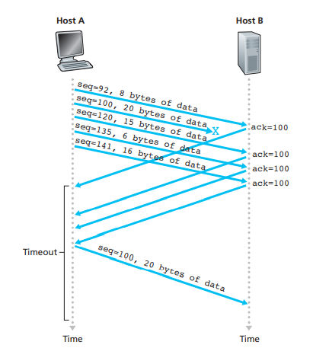
TCP fast retransmit

Slide 27
TCP flow control
application
process
application may
remove data from
TCP socket buffers ….
application
TCP socket
receiver buffers
OS
… slower than TCP
receiver is delivering
(sender is sending)
TCP
code
flow control
IP
code
receiver controls sender, so sender won’t overflow receiver’s buffer by transmitting too much, too fast
from sender
receiver protocol stack

Slide 28
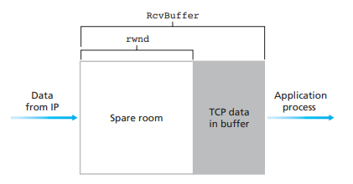
TCP flow control
receiver “advertises” free buffer space by including rwnd value in TCP header of receiver-to-sender segments
  RcvBuffer size (typical default is 4096 bytes)
sender limits amount of unacked (“in-flight”) data to receiver’s rwnd value
guarantees receive buffer will not overflow
receiver-side buffering
Notes:
Receive Window is a variable maintained by receiver.
LastByteRcvd – LastByteRead <= RcvBuffer(if RcvBuffer is equal to the opposite side equation, buffer is full else there is spare room)
rwnd = RcvBuffer – [LastByteRcvd – LastByteRead]
LastByteSent – LastByteAcked <= rwnd
Question: What happens when rwnd is 0!

Slide 29
TCP flow control
Receive Window is a variable maintained by receiver.
LastByteRcvd – LastByteRead <= RcvBuffer
if RcvBuffer is equal to left side equation, buffer is full else there is spare room
rwnd = RcvBuffer – [LastByteRcvd – LastByteRead]
LastByteSent – LastByteAcked <= rwnd
Question: What happens when rwnd is 0!

Slide 30
TCP flow control
Question: What happens when rwnd is 0!
Application process at receiver empties the buffer and
does not send new segment as receiver has nothing to send (neither data nor ACK).
So sender is unaware that space is there in receiver buffer and thus gets blocked
Solution:
TCP specification requires sender to send segment with one data byte when rwnd is 0.
Such segments will be ACKed by receiver and new ACKs will eventually contain non-zero rwnd values.

Slide 31
Principles of congestion control
congestion:
informally: “too many sources sending too much data too fast for network to handle”
different from flow control!
manifestations:
  lost packets (buffer overflow at routers)
  long delays (queueing in router buffers)
a top-10 problem!

Slide 32
TCP congestion control
TCP must use end-to-end congestion control rather than network-assisted congestion control
  since the IP layer provides no explicit feedback to the end systems regarding network congestion
TCP approach is to have each sender limit the rate at which it sends traffic into its connection as a function of perceived network congestion.

Slide 33
TCP congestion control
If there is little perceived congestion on the path between itself and the destination,
  then the TCP sender increases its send rate;
if the sender perceives that there is more congestion along the path,
  then the sender reduces its send rate.

Slide 34
TCP congestion control
How does a TCP sender limit the rate at which it sends traffic into its connection?
How does a TCP sender perceive that there is congestion on the path between itself and the destination?
What algorithm should the sender use to change its send rate as a function of perceived end-to-end congestion?

Slide 35
TCP congestion control
How does a TCP sender limit the rate at which it sends traffic into its connection?
In addition to send buffer, receive buffer and other variables like LastByteRead, rwnd etc)
Additional variable: congestion window (cwnd)
  Imposes a constraint on the send rate
Specifically, the amount of un-ACKed data at a sender may not exceed the minimum of cwnd and rwnd
LastByteSent – LastByteAcked <= min{cwnd, rwnd}

Slide 36
TCP congestion control
Assume TCP receive buffer is large enough, ignore rwnd constraint
  So, the amount of un-ACKed data is solely limited by cwnd
Further, assume sender always has data to send,
  all segments in the cwnd are sent
This constraint limits the amount of un-ACKed data at the sender
  Thus indirectly limits the sender’s send rate.

Slide 37
TCP congestion control
Consider a connection with negligible loss and packet transmission delays.
At start of each RTT
  the constraint permits the sender to send cwnd bytes of data into the connection;
At the end of the RTT
  the sender receives ACKs for the data.
By adjusting the value of cwnd,
  the sender can adjust send rate

Slide 38
TCP Congestion Control
sender sequence number space
TCP sending rate:
roughly: send cwnd bytes, wait RTT for ACKS, then send more bytes
cwnd
last byte
ACKed
last byte sent
sent, not-yet ACKed
(“in-flight”)
sender limits transmission:
cwnd is dynamic, function of perceived network congestion
cwnd
rate
~
bytes/sec
~
RTT
min{cwnd, rwnd}
<
LastByteSent - LastByteAcked

Slide 39
TCP congestion control
How does a TCP sender perceives that there is congestion on the path?
Loss event at a sender
  the occurrence of either a timeout or the receipt of three duplicate ACKs from the receiver.
When there is excessive congestion, then one (or more) router buffers along the path overflows, causing a datagram (containing a TCP segment) to be dropped.
  The dropped datagram, in turn, results in a loss event at the sender
    either a timeout or the receipt of three duplicate ACKs
  which is taken by the sender to be an indication of congestion on the sender-to-receiver path.

Slide 40
TCP congestion control
Optimistic case: Loss event does not occur
ACKs for Un-ACKed data will be received at sender.
  So ACKs indicate that all is well and increase its cwnd size (send rate)
If ACKs arrive at a relatively slow rate,
  then cwnd will be increased at a relatively slow rate.
If ACKs arrive at a high rate, then the cwnd will be increased more quickly.
Arrival of ACK is dependent on the end-end path and/or bandwidth of the link)
TCP is self-clocking as it uses ACKs for increasing its cwnd size

Slide 41
TCP congestion control
A lost segment implies congestion,
  rate should be decreased when a segment is lost.
An ACKed segment indicates all is well,
  rate can be increased when an original ACK arrives.
Bandwidth probing: how much increase or decrease?

Slide 42
TCP congestion control
What algorithm should the sender use to change its send rate as a function of perceived end-to-end congestion?

Slide 43
TCP congestion control: additive increase multiplicative decrease
approach: sender increases transmission rate (window size), probing for usable bandwidth, until loss occurs
  additive increase: increase cwnd by 1 MSS every RTT until loss detected
  multiplicative decrease: cut cwnd in half after loss
additively increase window size …
…. until loss occurs (then cut window in half)
AIMD: probing
for bandwidth
cwnd: TCP sender
congestion window size
time
Notes:
At triple duplicate ACK event occurs [ ignore initial slow start period when a connection begins]
Linear (additive) increase and multiplicative decrease

Slide 44
TCP congestion control Algorithm
Described [Jacobson 1988] and is standardized in [RFC 5681].
Three major components:
slow start [Mandatory]
congestion avoidance [Mandatory], and
fast recovery [recommended but not required].
Slow start and congestion avoidance differ in how they increase the size of cwnd in response to received ACKs.
  slow start increases the size of cwnd more rapidly (despite its name) than congestion avoidance.

Slide 45
TCP Slow Start
Host A
Host B
when connection begins, increase rate exponentially until first loss event:
  initially cwnd = 1 MSS
  double cwnd every RTT
  done by incrementing cwnd for every ACK received
summary: initial rate is slow but ramps up exponentially fast
one segment
RTT
two segments
four segments
time
Notes:
- Initial sending rate is MSS/RTT [ if MSS = 500 bytes and RTT = 200 msec, the resulting initial sending rate is only about 20 kbps]

Slide 46
TCP: detecting, reacting to loss
loss indicated by timeout:
  cwnd set to 1 MSS;
  window then grows exponentially (as in slow start) to threshold, then grows linearly
loss indicated by 3 duplicate ACKs:
TCP Tahoe (old TCP) always sets cwnd to 1 (timeout or 3 duplicate acks)
TCP RENO
  dup ACKs indicate network capable of delivering some segments
  cwnd is cut in half window then grows linearly

Slide 47
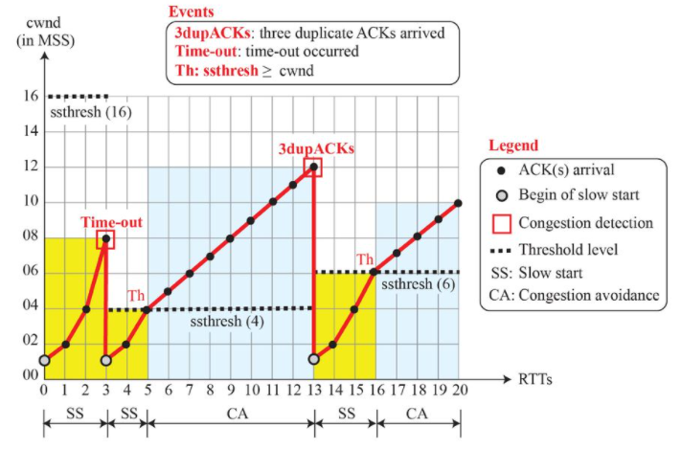
TCP Tahoe: Example

Slide 48
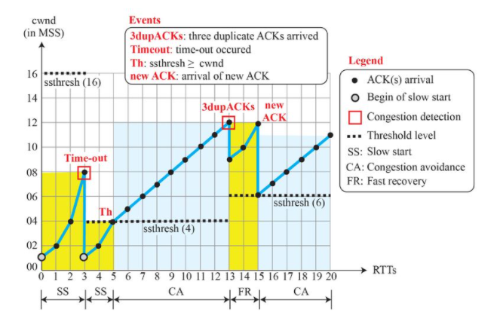
TCP Reno: Example

Slide 49
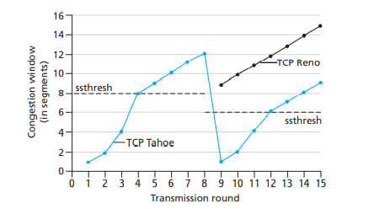
TCP: switching from slow start to CA
Q: when should the exponential increase switch to linear?
A: when cwnd gets to 1/2 of its value before timeout.
Implementation:
variable ssthresh
on loss event, ssthresh is set to 1/2 of cwnd just before loss event
Notes:
TCP reno implmenets Fast recovery.

Slide 50
TCP: Reliable stream transport
Reliability is achieved by buffering data combined with positive ACKs and retransmissions
Before any data are transported, the two connection end points must explicitly set up a connection.
A connection is identified by the IP addresses and TCP port numbers of the end points
Many application layer protocols are defined over TCP,
  such as HTTP (Web), SMTP (e-mail), and XMPP (instant messaging).

